Slide 1
DEMYSTIFYING PEER REVIEW: NIH, NSF, DOD
Overall Peer Review Process, Preparing an application
Grant Writing A, B, C, D
Successful & Unsuccessful Grant Application
What reviewers look for in an application
Common Problems in applications
A Window to your application, eRA commons
NIH resubmission policy
F30, F31, F99/K00, NSF-GRFP, DOD Horizon Award, NIH K awards
F32 Postdoctoral fellowship review criteria and tips
CSR & NIH Information Sources
Who can answer your questions, Grants information website
History of Peer Review

Slide 2
EDUCATION
MS Major Physiology, Wilson College, Bombay
MS Biological Oceanography, University of Rhode Island, Rhode Island, USA
PhD. Physiology, Oregon State University, Oregon. 1970
Research Associate, University of Nebraska, Lincoln, NE
Research Associate, George Washington University of Medical School, Department of Anatomy

Slide 3
Recent Peer Review at NIH
NICHD/NIH, USA (National Institute of Child Health and Human Development)
Grants & Proposals
Retired July 2019
CSR/NIH, Retired Dec 31, 2010
4 S Foundation
President, Sheela Nayak ,

Slide 4
Experience in Peer Review
Center for Scientific Review/NIH: 30 years
SRA International INC: 5 years
CDC in Atlanta: 2 years
NIDA Review Branch, NIAMS Review Branch: 2 years
NICHD/NIH Review Branch: 2 years
Susan G. Komen Foundation grants
Referral Officer: 15 years

Slide 5
Academic Experience
George Washington University Medical School, Department of Anatomy, Washington, DC
Faculty of Science, Kuwait University, Kuwait
Royal Institute of Science, Bombay, India

Slide 6
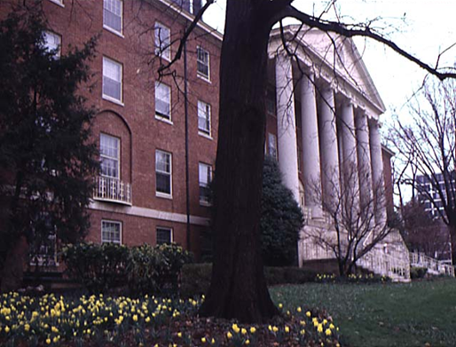
National Institutes of Health
Much of the biomedical research in the United States is supported by the Federal Government, primarily the National Institutes of Health (NIH)

Slide 7
NIH . . . Turning Discovery Into Health
NIH’s mission is to seek fundamental knowledge about the nature and behavior of living systems and the application of that knowledge to enhance health, lengthen life, and reduce illness and disability.

Slide 8
National Institutes of Health

Slide 9
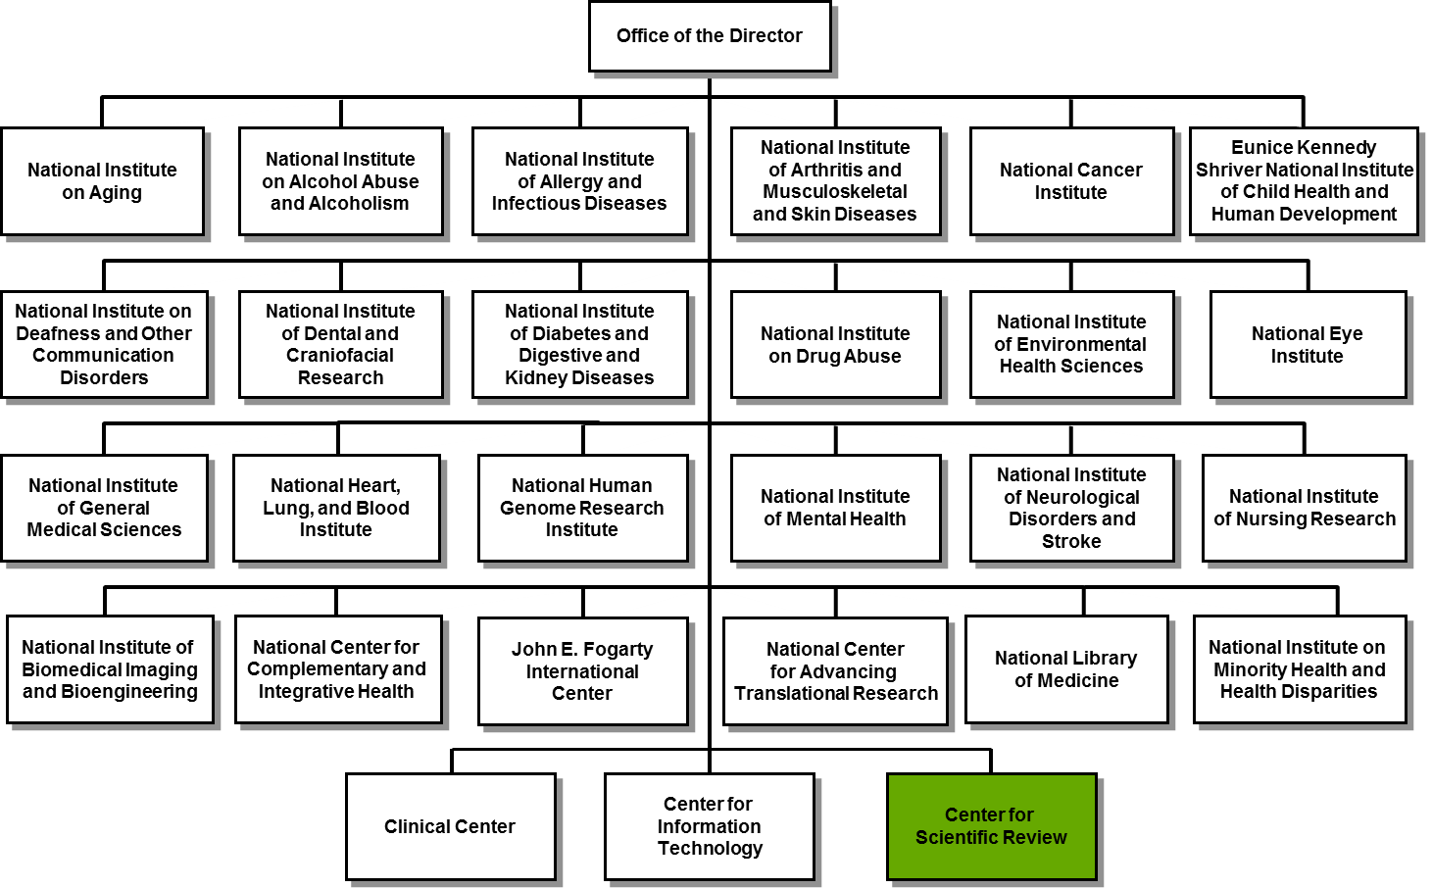
Your Application Could Be Funded by One of 24 NIH Institutes or Centers

Slide 10
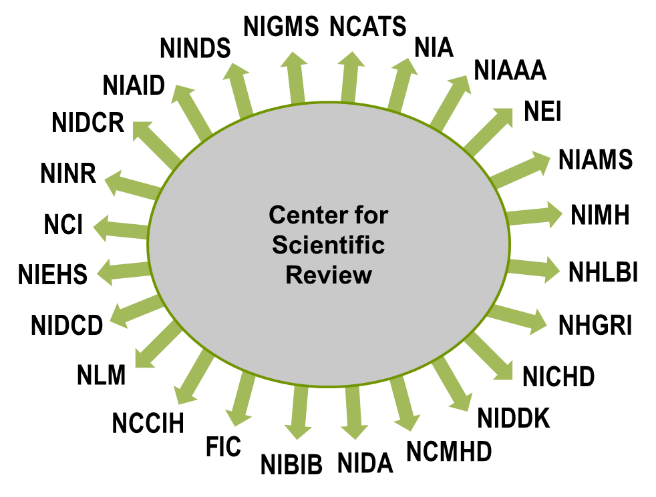
24 NIH Institutes and Centers Fund Grants

Slide 11
Overall Peer Review Process

Slide 12
NIH Peer Review System for Grant Applications

Slide 13
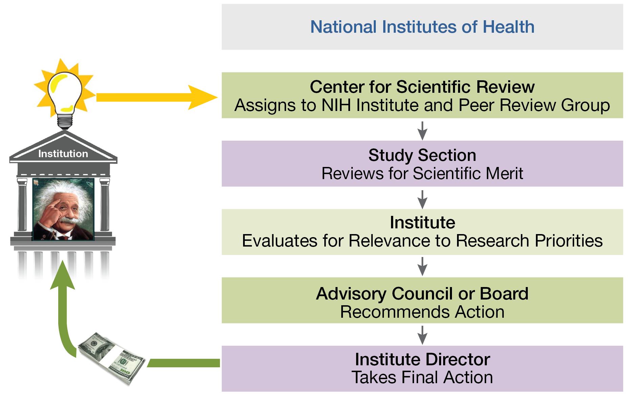
Peer Review and Funding of NIH Grant Applications
Notes:
How NIH Peer Review Works
NIH has a two-stage review process powered by the input of multiple external experts and other stakeholders. Stage One: Evaluation for Scientific Merit by external scientific experts from academia and industry. Stage Two: Evaluation for Relevance to Research Priorities by the relevant NIH Institute or Center, which consults more senior scientific experts, patients and patient advocates on its Advisory Council.

Slide 14
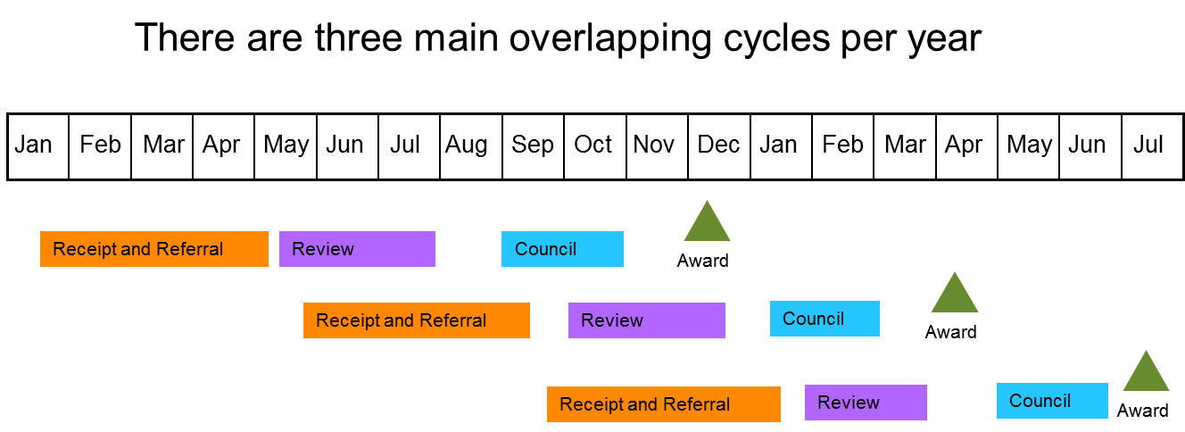
Overall Timeframe from Submission to Award
http://grants1.nih.gov/grants/funding/submissionschedule.htm
Notes:
At NIH there are three major calendar cycles of this process that are staggered in overlap at any given time of the year. The NIH guide to grants and contracts details for you the specified application deadlines that initiate each cycle.

Slide 15
NIH Peer Review System for Grant Applications
Jan-May May-Sept Sept-Jan | Receipt Dates
May-July Sept-Nov Jan-Mar | Review Dates
Sept-Oct Jan-Feb May-June | National Advisory Council/Board Dates
Dec Apr July | Earliest Possible Beginning Date
http://grants1.nih.gov/grants/funding/submissionschedule.htm

Slide 16
Timetable for New Investigator R01 Grant Applications
Due Dates for New R01 (A0) | Summary Statement Release | Due Date for Next Round Resubmission (A1)
February 5 | July 10 | August 10
June 5 | November 10 | December 10
October 5 | March 10 | April 10
http://grants.nih.gov/grants/guide/notice-files/not-od-11-057.html

Slide 17
Center for Scientific Review (CSR)

Slide 18
CSR Mission
To see that NIH grant applications receive fair, independent, expert, and timely reviews – free from inappropriate influences – so NIH can fund the most promising research.

Slide 19
Center for Scientific Review
Serves as central receipt point for grant applications submitted to NIH and some other DHHS agencies
Assigns applications to CSR review groups/study sections or Institute scientific review groups
Assigns applications to NIH Institute(s)/Center(s) as potential funding component(s)
Conducts initial scientific merit review of most research applications submitted to the NIH in about 240 Study Sections and regularly recurring Special Emphasis Panels

Slide 20
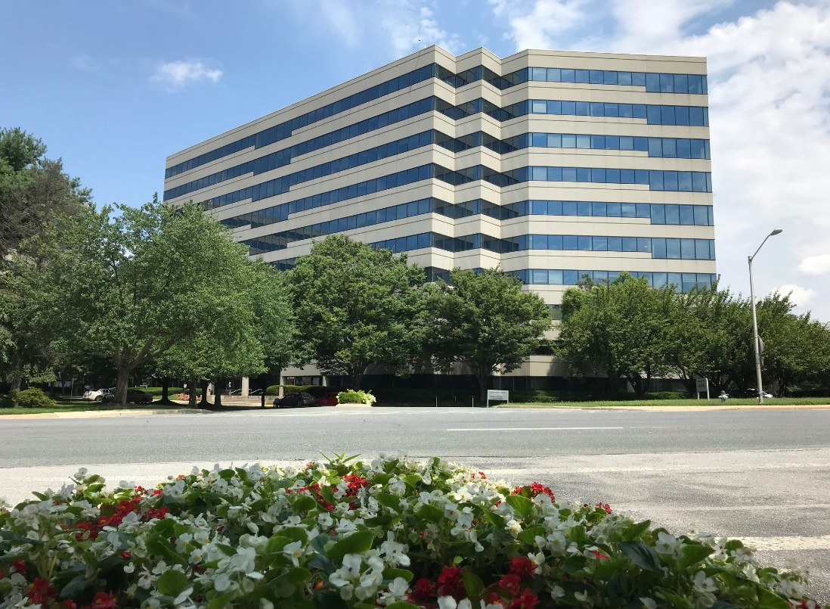
The Gateway for NIH Grant Applications
The Center for Scientific Review
Receives all NIH applications
Refers them to NIH Institutes/Centers and to scientific review groups
Reviews the majority of NIH grant applications for scientific merit

Slide 21
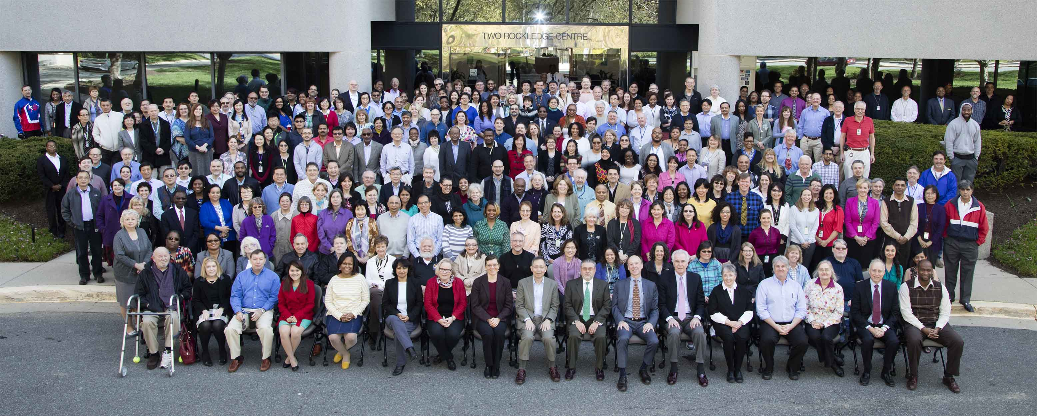
This Is CSR

Slide 22
CSR Peer Review – Fiscal Year 2018
82,000 applications received
62,000 applications reviewed
18,000 reviewers
245 Scientific Review Officers
1,600 review meetings

Slide 23
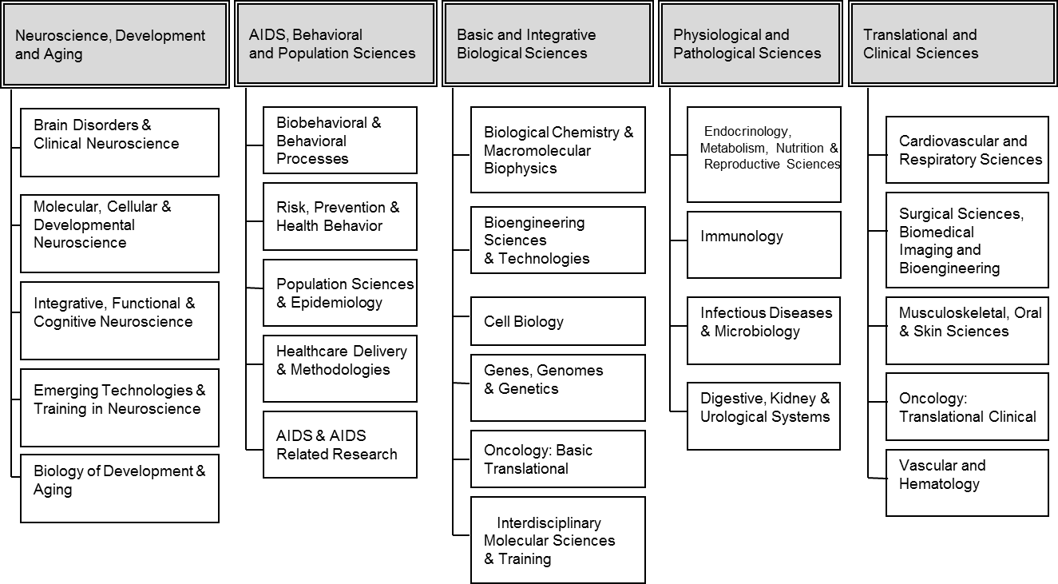
Divisions and Integrated Review Groups (IRGs)

Slide 24
Division of AIDS, Behavioral and Population Sciences
Integrated Review Groups
Biobehavioral & Behavioral Processes
Risk, Prevention & Health Behavior
Population Sciences and Epidemiology
Healthcare Delivery & Methodologies
AIDS and Related Research
Social Sciences and Population Studies
Behavioral Genetics and Epidemiology
Cardiovascular and Sleep Epidemiology
Epidemiology of Cancer
Kidney, Nutrition, Obesity, & Diabetes Epidemiology
Infectious Diseases, Reproductive Health, Asthma and Pulmonary Epidemiology
Neurological, Aging and Musculoskeletal Epidemiology

Slide 25
Cell Biology Integrated Review Group
Biology of Visual Systems BVS
Nuclear & Cytoplasmic structure/function and dynamics study section NCSD
Cellular Mechanisms in Aging and Development SS CMAD
Cellular Signaling & Regulatory Systems Study Section CSRS
Develop 1 and 2 Study Section DEV 1 and DEV 2
Intercellular Interactions Study Section ICI
Membrane Biology and Protein Processing Study Section MBPP
Molecular and Integrative Signal Transduction Study Section MIST

Slide 26
Center for Scientific Review
Referral
Central receipt point for most PHS Grant Applications
Institute/Center assignment (potential funding component)
Assignment to Scientific Review Group in CSR or in an Institute
Scientific Review
Approximately 240 CSR chartered study sections and regularly recurring Special Emphasis Panels that primarily review:
Research Grant Applications
Fellowship Applications
Academic Research Enhancement Award Applications
Small Business Innovation Research Applications

Slide 27
Application Receipt and Assignment

Slide 28
Find a Funding Opportunity (FOA)
NIH 2020 budget: $42.1 billion (3 billion increase, 7.7% boost)
NSF2020 budget: $7.1 billion will support about 8,000 research grants.
https://grants.nih.gov/funding/searchguide/index.html

Slide 29
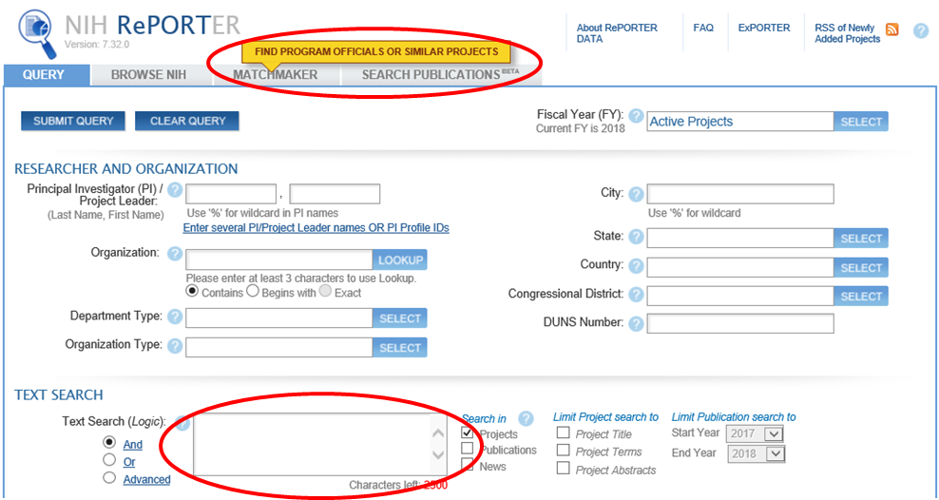
Help Your Application Get to the Right Institute
http://projectreporter.nih.gov/reporter.cfm

Slide 30
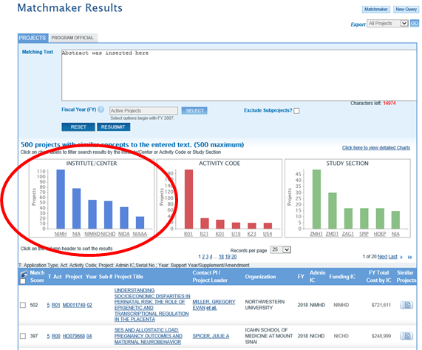
How to Find an Institute, Step 2
Copy abstract/Aims
Matchmaker Search returns:
List of Institutes
List of funded grants
Link to Program Officials

Slide 31
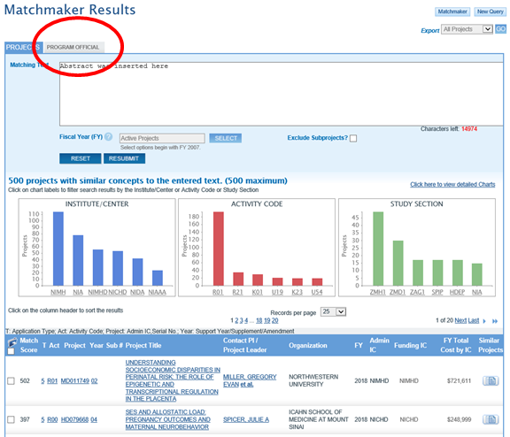
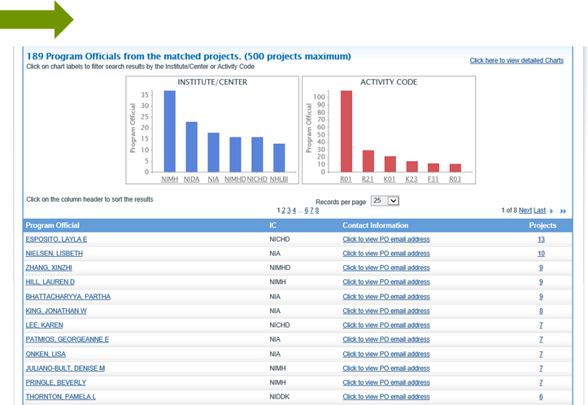
Find Program Officer to Discuss
Notes:
If you click on the program official Tab in the red circle, you can find the contact information for the program officials who manage similar applications so if you need to discuss more with program about your science and the fit for their Institute., here is the list of contact person that you can use to get that information.

Slide 32
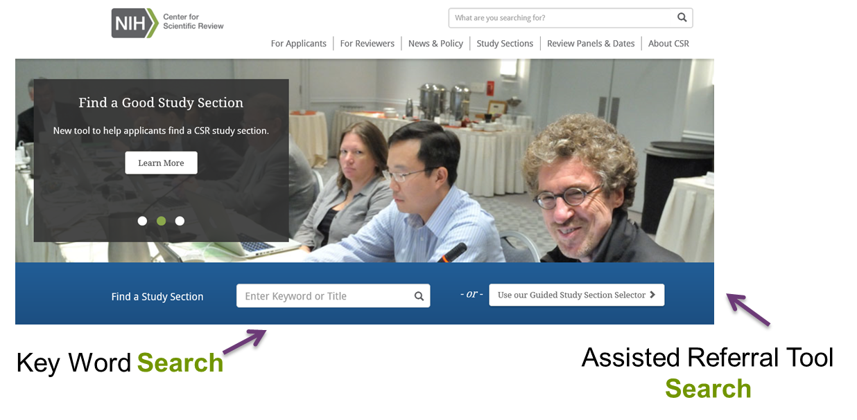
Help Your Application Get to the Right Study Section
http://www.csr.nih.gov

Slide 33
Assisted Referral Tool
https://art.csr.nih.gov/

Slide 34
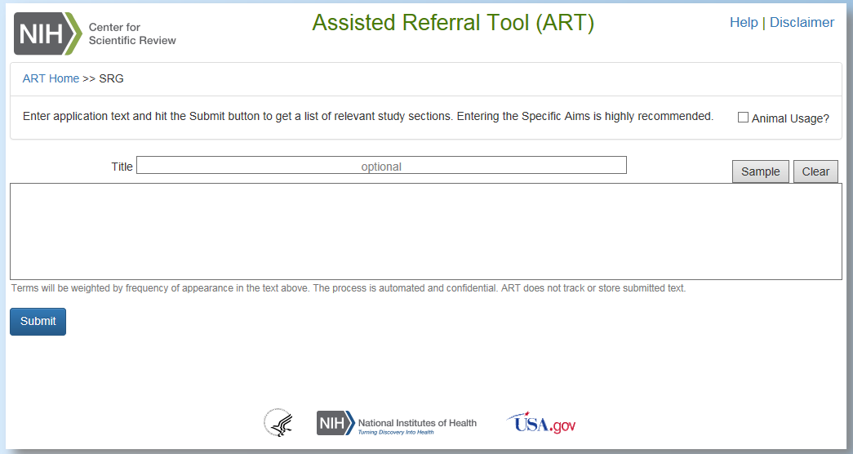
Assisted Referral Tool

Slide 35
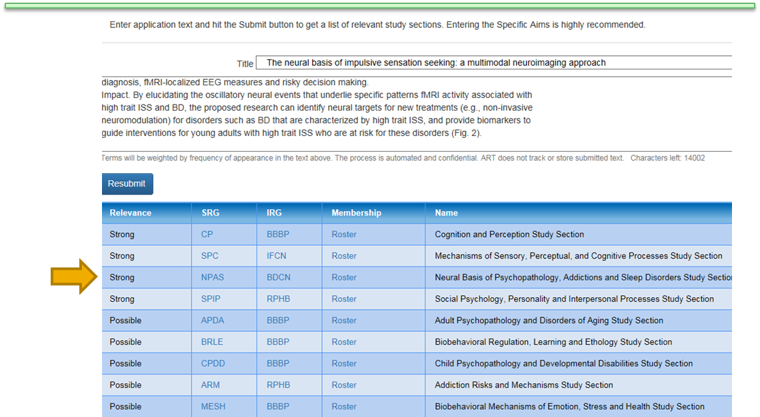
Example of ART Recommended Study Section/IRG

Slide 36
How to Find a Study Section, Browse
https://public.csr.nih.gov/StudySections
Notes:
Alternatively, if you just like to browse CSR website, you can browse the clusters of study sections called IRGs or integrated review groups and you can look at the individual study sections in the Clusters and get more information about them.

Slide 37
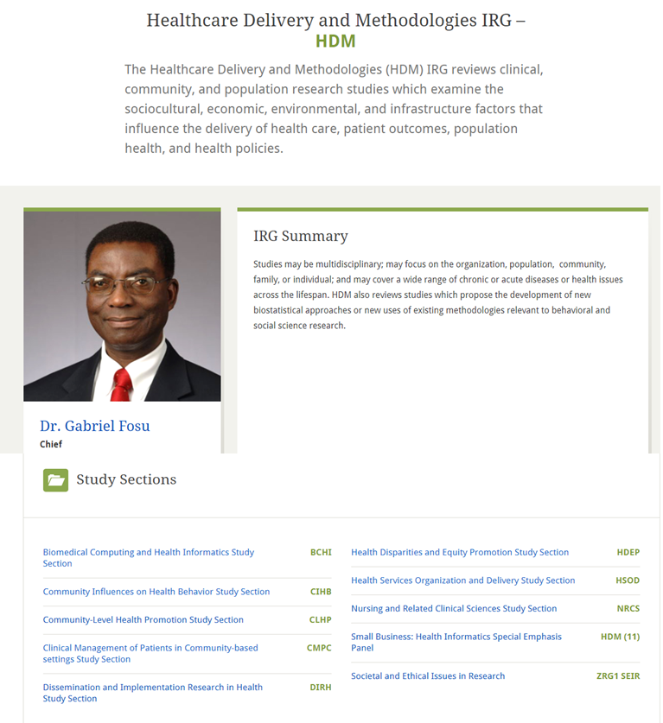
Help Your Application Get to the Right Study Section
Integrated Review Group

Slide 38
Help Your Application Get to the Right Study Section
Study Section

Slide 39
Assignment Request Form (ARF)
The ARF replaces many functions of the cover letter.
Use it to:
Make assignment requests
Identify potential conflicts of interest
List areas of expertise needed to evaluate the application
You should never suggest specific reviewers

Slide 40
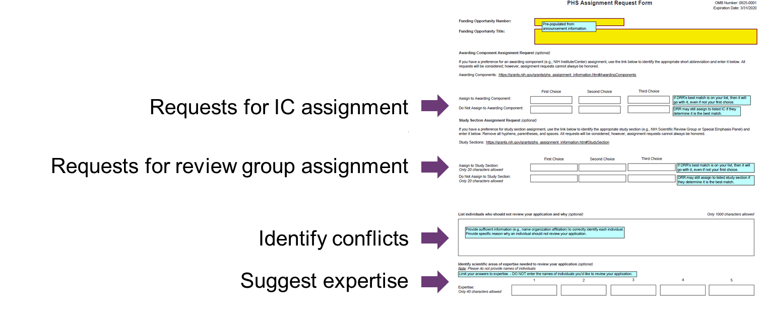
Assignment Request Form (ARF)
Notes:
This is what the form looks like and there's places to put in both positive and negative request for institute assignments. Please assign me to please don't assign me to positive and negative request for study section assignments. A text box to put in information about conflict or expertise needed.

Slide 41
Cover Letter
You can use a cover letter to:
Explain why your application is late
Provide notice of plans to submit a video
Identify your project as generating large-scale genomic data
Provide pre-approvals ($500k, conference grants)
You should NOT use a cover letter to:
Make assignment requests (use the ARF!)
Suggest specific reviewers (never do this!)

Slide 42
Applications Are Assigned by:
Referral Officers
Professional scientists, most of whom also serve as scientific review officers of CSR study sections

Slide 43
Your Application is . . .
Checked for being on time, formatted correctly and complete
Assigned to a Scientific Review Group
Assigned to an NIH Institute or Center

Slide 44
Applications Are Assigned to:
Institutes or Centers based on─
Overall mission and guidelines of the Institute or Center
Specific programmatic mandates and interests of the Institute or Center
Integrated Review Groups based on─
Specific review guidelines for each Integrated Review Group (IRG)

Slide 45
Assignment to CSR Study Sections
Within an IRG, applications are assigned to:
Standing Study Sections
When subject matter of application matches the referral guidelines for the study section or
Special Emphasis Panels (SEPs)
When the subject matter does not fit into any study section
When assignment of an application to the most appropriate study section creates a conflict of interest
When certain types of grants are sought (e.g., fellowships, SBIRs, AREAS)

Slide 46
Assignment to Institutes
Applications are referred to an Institute or Center as the potential funding component.
This assignment is based on a match between the research proposed and the overall mission of the Institute or Center.
Dual assignments are made where applications are appropriate for more than one Institute or Center.

Slide 47
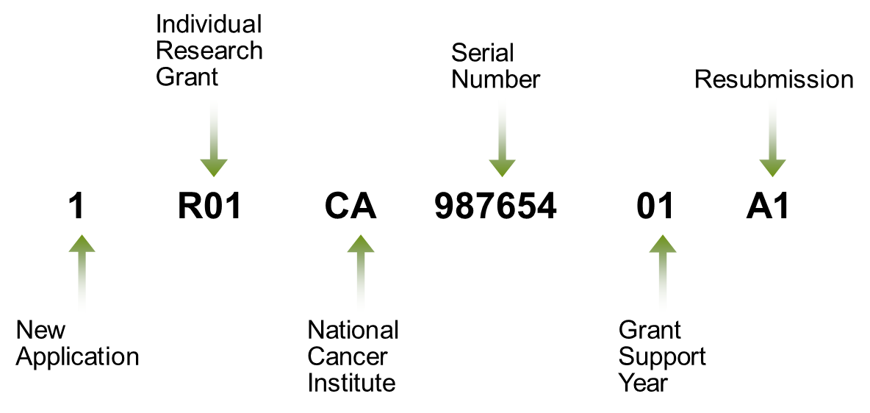
Sample Application Number

Slide 48
How NOT to Submit a Late Application
Start Early!
Application must be accepted TWICE: Grants.gov and NIH
Check eRA Commons for your submitted application
(e-mails are sent but can be caught in SPAM filters)
High volume at deadlines slows processing/validation time
On time application = submitted error-free by 5 PM local time on due date
Errors cause rejection – Warnings are error-free and accepted
No error correction window that extends deadline

Slide 49
Keep Track of Your Application
AORs submit applications
PD/PIs responsible for accuracy of submission
Do not wait for e-mails; proactively check eRA Commons
If you cannot see your application in eRA Commons, neither can we!
Remember
It is your career and your livelihood on the line
Do not make any assumptions!
Notes:
Some important reminders. The Authorized Organizational Representative (AOR) in your grants office is responsible for submitting your application on time, but you are responsible for the content. Do not sit back and wait for e-mails. Proactively check your eRA Commons account. If you cannot see your application in Commons, neither can we, and if we can’t see it we can’t review it. Start the submission process early – days early rather than hours early – so that you have plenty of time to view your application after it is complied on Commons. Sometimes things don’t look the same in Commons as it did on your office computer. Take the time to look at the application the way your reviewers will see it. Attachments such as letters of support can be omitted. Give yourself plenty of time to submit a corrected copy if necessary. We cannot accept missing pieces or corrected pages after the deadline.

Slide 50
A Window to Your Application: eRA Commons
eRA Commons is an online interface where a grant applicant can:
Check submitted grant application for errors and warnings and view final image
Track review assignment, view review outcomes (score, summary statements), find contact info
Update Personal Profile to ensure Early Stage Investigator eligibility is in place
Submit pre-award information (just in time)
View Notice of Award and other key documents
And much more!
https://commons.era.nih.gov/commons/
Notes:
One more very important reminder that eRA commons is THE place to make sure your application shows up and it looks right. You can access any error or warning messages on eRA Commons. You can track your application through the system. It takes about 2 weeks for the application to make it through the full receipt and referral process and so you can watch it as it goes through the process. You will see the Institute assignment, you will see the SRO assignment and you will see contact information for people in case you have any questions. You'll find that all on the status page for your application in eRA Commons plus there's much more you can do there so it's definitely a website that you should become familiar with and use often. Finally thank you for your time and best of luck with your Grant submission.

Slide 51
The Study Section

Slide 52
Division of AIDS, Behavioral and Population Sciences
Behavioral Genetics and Epidemiology Study Section
Cancer, Heart, and Sleep Epidemiology A Study Section
Cancer, Heart, and Sleep Epidemiology B Study Section
Infectious, Reproductive, Asthma and Pulmonary Conditions Study Section
Kidney, Nutrition, Obesity and Diabetes Study Section
Neurological, Aging and Musculoskeletal Epidemiology Study Section
Social Sciences and Population Studies Study Section
Integrated Review Groups
Biobehavioral & Behavioral Processes
Risk, Prevention & Health Behavior
Population Sciences and Epidemiology
Healthcare Delivery & Methodologies
AIDS and Related Research

Slide 53
Peer Review in CSR
CSR Study Sections are managed by a Scientific Review Officer (SRO) who is a doctoral-level professional, whose scientific background is close to the focus of the study section.
Each CSR standing study section has 12-25 regular members who are from the scientific community.
Temporary members are recruited as needed.
About 60-100 applications are normally reviewed at each study section meeting.

Slide 54
Role of the Scientific Review Officer
Designated Federal Official with overall responsibility for the review process
Performs administrative review of applications to ensure completeness and accuracy
Selects reviewers based on broad input
Manages study section meetings
Prepares summary statements

Slide 55
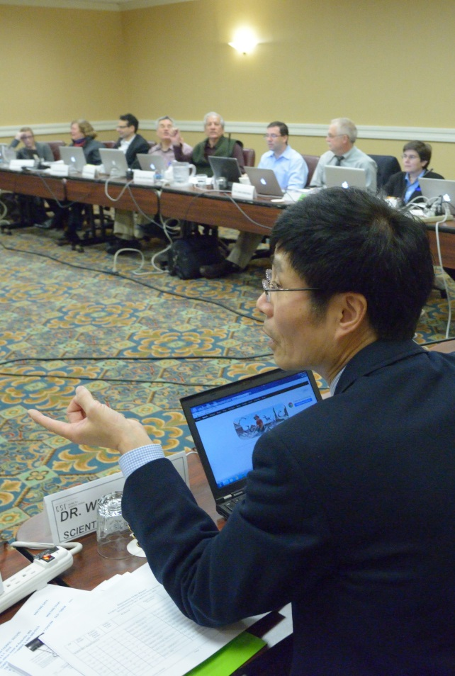
Scientific Review Officer
Designated Federal Official with overall responsibility for the review process
Doctoral level scientist with expertise related to science reviewed in their study section.
Legal responsibility for study section and management of review.
Provides written (summary statement) reports to ICs for second review.

Slide 56
Extramural Support Assistant
Assists Scientific Review Officer with administrative and technical review of applications
Makes preparation for study section meetings and project site visits
Shares administrative responsibilities at meetings
Prepares preliminary summary statements for Scientific Review Officers

Slide 57
SROs Seek Reviewers Who Are Recognized Authorities in Their Field
Doctoral degree or equivalent
Demonstrated scientific expertise/research support
Mature judgment and breadth of perspective
Work effectively in a group context
Impartiality
Inclusion of women and minority scientists
Geographic distribution

Slide 58
Where Do We Find Reviewers?
Successful applicants
Recommendations from reviewers and NIH staff
NIH RePORTER (http://projectreporter.nih.gov/reporter.cfm)
NIH PI and reviewer databases
Internet
Scientific conferences
Volunteers

Slide 59
The SRO Selects a Chair Among the Panel Who...
Has a particularly strong scientific and NIH funding track record
Is a leader in her or his specialty
Has an especially broad perspective
Communicates particularly well
Has a particularly strong reputation for impartiality
Notes:
Summarize slide

Slide 60
Before the Study Section Meeting
Each application is assigned to 3 or more reviewers 5-6 weeks in advance
Reviewers assess each application by providing:
A preliminary Overall Impact score
Criterion Scores for each of the 5 Core Review Criteria
A written critique

Slide 61
The SRO Assigns at Least Three Reviewers to an Application
Notes:
In preparation for a study section meeting, at least three scientists with broad experience in the external scientific community are assigned to your application by the SRO. Additional reviewers may be recruited to ensure your application is reviewed appropriately.
For most panels, reviewers receive their assignments approximately 6 – 8 weeks in advance of the review meeting. They are asked to read their assigned applications, then d draft preliminary critiques of each, and submit preliminary merit scores about one week prior to the meeting.

Slide 62
Reviewer Conflicts of Interest (COI)
What Constitutes a Reviewer COI?
Institutional
Family member/close friend
Collaborator/Key Personnel
Longstanding scientific disagreement
Personal bias
Appearance of conflict
http://grants.nih.gov/grants/peer/peer_coi.htm

Slide 63
Confidentiality
Review materials and proceedings of review meetings represent confidential information for reviewers and NIH staff.
At the end of each meeting, reviewers must destroy or return all review-related material.
Reviewers should not discuss review proceedings with anyone except the SRO.
Questions concerning review proceedings should be referred to the SRO.
Applicants should never communicate directly with any members of the study section about an application.

Slide 64
Role of Study Section Chair
Partners with their Scientific Review Officer to conduct the meeting
Guides and summarizes study section discussion
Ensures all study section member opinions are given careful consideration
Manages scientific discussions at the meeting, e.g., timeliness and thoroughness

Slide 65
The Study Section Meeting

Slide 66
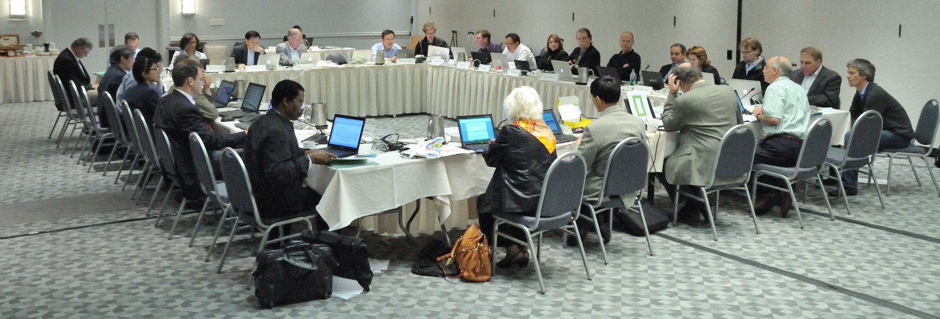
What Happens at Your Review Meeting?
Notes:
Approximately 6 – 8 weeks after the SRO has issued review assignments and one week after panelists have submitted preliminary critiques and scores, the review meeting is convened with the SRO as the official government representative.

Slide 67
At the Meeting
Order of Review
Applications to be discussed are reviewed in random order.
Clustering of Review
New Investigator R01 applications are clustered
Clinical applications & other mechanisms may be clustered (n ≥ 20)
Not Discussed Applications
About half the applications will be discussed
Applications unanimously judged by the review committee to be in the lower half are not discussed

Slide 68
At the Meeting: Application Discussion
Any member in conflict with an application leaves the room
Reviewer 1 introduces the application and presents critique
Reviewers 2 and 3 highlight new issues and areas that significantly impact scores
All members without a conflict are invited to join the discussion and then vote on the final overall impact score

Slide 69
CSR Study Sections: The Meeting
Each CSR standing Study Section has ~12-22 regular members plus temporary reviewers from the scientific community
About 70 applications are reviewed by each study section in 1-2 day meetings

Slide 70
Discussions Focus on the Best Applications
Reviewers typically discuss the top half of the applications and assign final impact scores
The panel will discuss any application a reviewer wants to discuss
Notes:
The remaining applications will not be discussed unless explicitly recalled by any member of the panel. Even if your application is not discussed, you will receive the detailed critiques from each of your assigned reviewers.
We've talked broadly about evaluation and alluded to scoring. Let's look at more detail of how this is done.

Slide 71
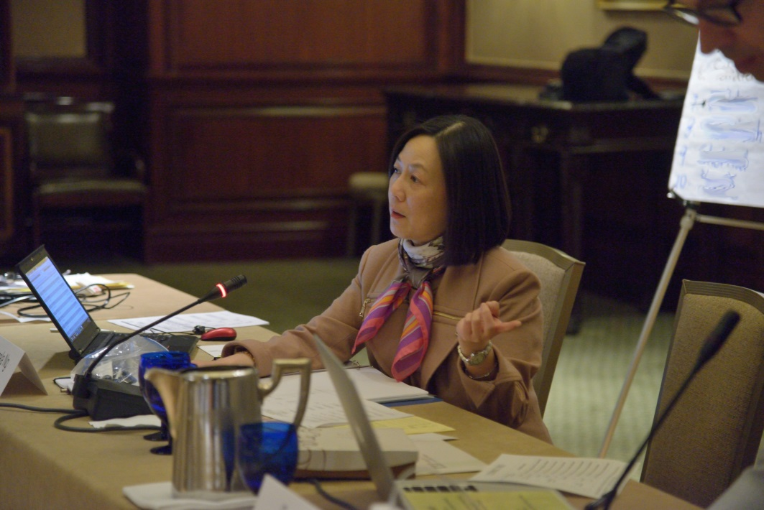
Your Scientific Review Officer
During and After the
Review Meeting
Manages the meeting
Prepares summary statements
Provides information to NIH Institutes and Centers

Slide 72
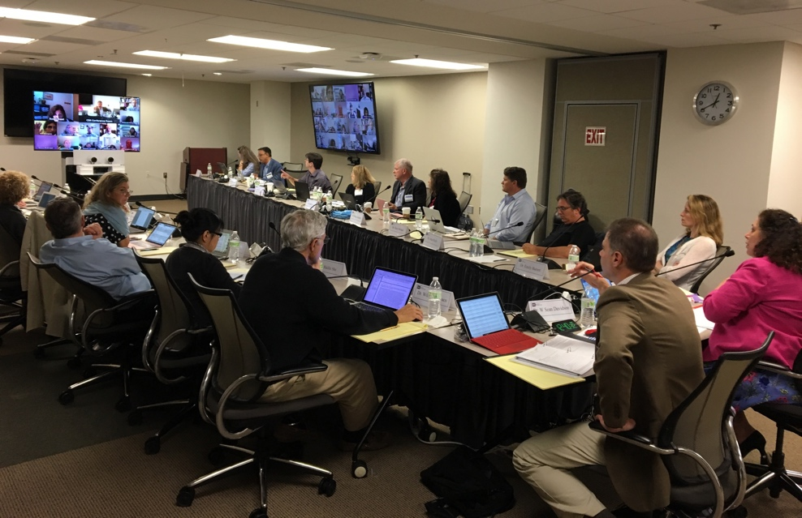
Your Application May Be Reviewed Electronically
Electronic tools may be used to facilitate reviewer participation
Electronic Review Platforms
Telephone Assisted Meetings
Virtual Internet Meetings
Video Assisted Meetings

Slide 73
Review Criteria
5 Scored Review Criteria
Overall Impact
Significance
Investigator(s)
Innovation
Approach
Environment
Assessment of the likelihood for the project to exert a sustained, powerful influence on the research field(s) involved
Each scored from 1-9 Scored from 1-9

Slide 74
Reviewing Rigor and Transparency Research Project Grant Applications
Rigor and Transparency Element | Which applications? | Where in the application? | Which Criteria? | What’s added to the review criteria? | Affect overall impact score?
Rigor of Prior Research | All | Research Strategy | Significance | Is the prior research that serves as the key support for the proposed project rigorous? | Yes
 |  | Research Strategy (Approach) | Approach | Have the investigators included plans to address weaknesses in the rigor of prior research that serves as the key support for the proposed project | Yes
Scientific Rigor | All | Research Strategy (Approach) | Approach | Are there strategies to ensure a robust and unbiased approach? | Yes
Consideration of Relevant Biological Variables, Such as Sex | Projects with vertebrate animals and/or human subjects | Research Strategy (Approach) | Approach | Are adequate plans to address relevant biological variables, such as sex, included for studies in vertebrate animals or human subjects? | Yes
Authentication of Key Biological and/or Chemical Resources | Project involving key biological and/or chemical resources | New Attachment | Additional review considerations | Comment on plans for identifying and ensuring validity of resources. | No

Slide 75
Four Rigor and Transparency Review Elements Research Project Grant Applications
Can Affect Your Overall Impact Score!
Rigor and Transparency Element | What’s added to the review criteria? | Where in the application?
1. Rigor of Prior Research | Is the prior research that serves as the key support for the proposed project rigorous? | Research Strategy (Significance)
 | Have the investigators included plans to address weaknesses in the rigor of prior research that serves as the key support for the proposed project? | Research Strategy (Approach)
2. Scientific Rigor | Are there strategies to ensure a robust and unbiased approach? | Research Strategy (Approach)
Notes:
Rigor and transparency do not apply to all applications. See List of Eligible Activity Codes: https://nih-extramural-intranet.od.nih.gov/d/sites/default/files/RigorActivityCodes-20151006.pdf. Also, certain Funding Opportunity Announcements are exempt from rigor, by request from the ICs.

Slide 76
Four Rigor and Transparency Review Elements Projects with Vertebrate Animals and/or Human Subjects
Can Affect Your Overall Impact Score!
Rigor and Transparency Element | What’s added to the review criteria? | Where in the application?
3. Consideration of Relevant Biological Variables, Such as Sex | Are adequate plans to address relevant biological variables, such as sex, included for studies in vertebrate animals or human subjects? | Research Strategy (Approach)

Slide 77
Four Rigor and Transparency Review Elements Projects Involving Key Biological and/or Chemical Resources
Rigor and Transparency Element | What’s added to the review criteria? | Where in the application?
4. Authentication of Key Biological and/or Chemical Resources | Comment on plans for identifying and ensuring validity of resources. | New Attachment
Won’t Affect Your Overall Impact Score

Slide 78
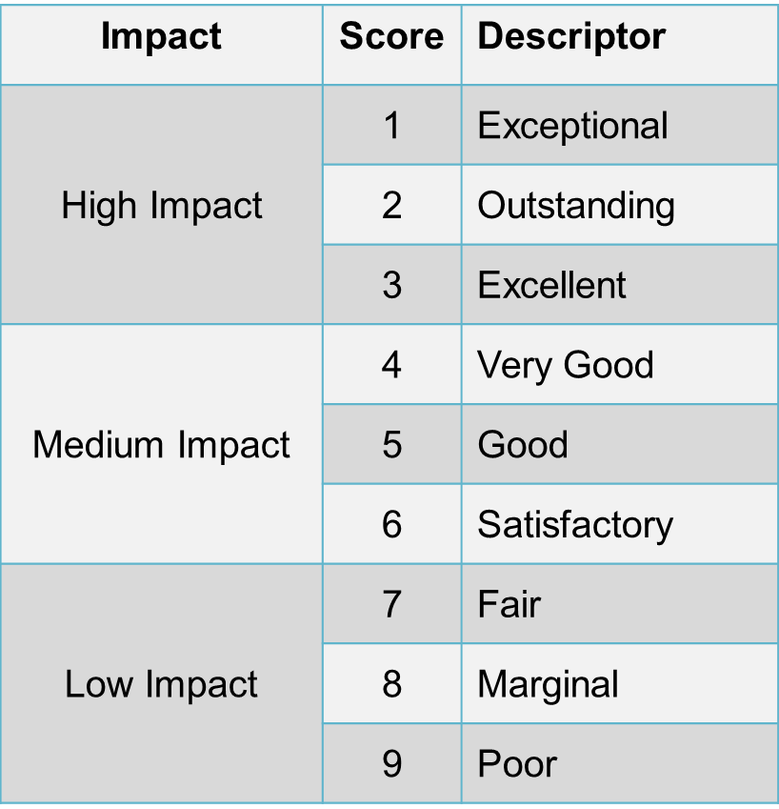
9-Point Criteria Scoring Scale

Slide 79
Scoring Overall Impact
Overall Impact | Scores | Examples
High | 1 2 3 | Applications address a problem of high importance/interest in the field. May have some or no technical weaknesses.
Medium | 4 5 6 | Applications may address a problem of high importance in the field, but weaknesses in the criteria bring down the overall impact to medium. Applications may address a problem of moderate importance in the field, with some or no technical weaknesses.
Low | 7 8 9 | Applications may address a problem of moderate/high importance in the field, but weaknesses in the criteria bring down the overall impact to low. Applications may address a problem of low or no importance in the field, with some or no technical weaknesses.

Slide 80
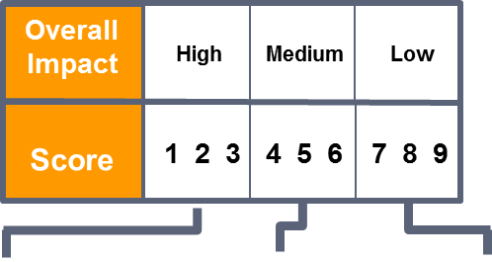
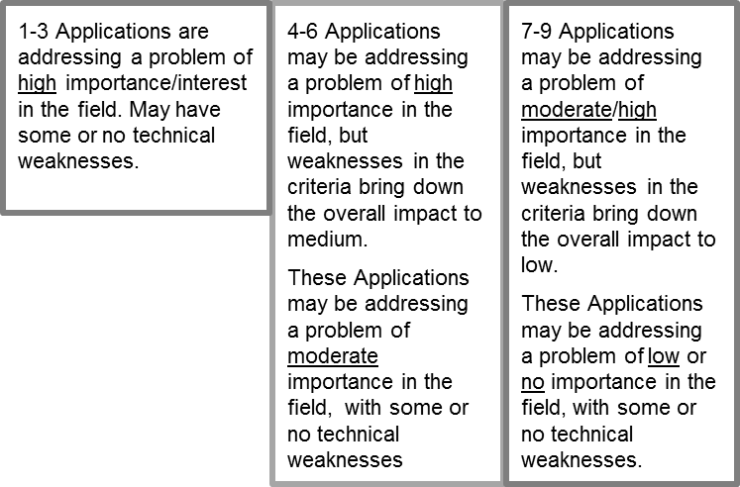
Scoring Overall Impact
Overall Impact:
The likelihood for a project to exert a sustained, powerful influence on research field(s) involved
Evaluating Overall Impact:
Consider the 5 criteria: significance, investigator, innovation, approach, environment (weighted based on reviewer’s judgment) and other score influences, e.g. human subjects
5 is a good medium-impact application

Slide 81
Scoring
9-point score scale is used to provide:
Criterion Scores for each of the 5 core review criteria
Overall Impact/Priority Score based on but not a sum of the core criterion scores plus additional criteria
All applications receive scores:
Not discussed applications will receive only initial criterion scores from the three assigned reviewers.
Discussed applications also receive an averaged overall impact score from eligible (i.e., without conflicts of interest) panel members.

Slide 82
Scoring
Score applications on five core criteria using a scale of 1-9
Preliminary overall impact/priority score using 1-9 scale
Discussed applications receive an overall score from each eligible (i.e., without conflicts of interest) panel member, and these scores will be averaged to one decimal place, and multiplied by 10. The 81 possible priority scores will thus range from 10-90.
All applications will receive scores:
Not discussed applications will receive initial criterion scores from the three assigned reviewers.

Slide 83
Not Discussed
Reviewers discuss half of the applications, beginning with the best
The panel will discuss any application any reviewer wants to discuss
Not discussed applications will only have assigned criterion scores

Slide 84
Additional Issues in Assessing Overall Impact
Protections of human subjects
Inclusions of women, minorities and children
Appropriate use of vertebrate animals
Management of biohazards

Slide 85
Research Involving Human Subjects
Important Considerations
Is the proposed study exempt from human subject review?
Are there any apparent physical, psychological or social risks to the human subjects?
Are the protections adequate?
What are the potential benefits to the subjects and to mankind?
Are the inclusions of minorities and both genders adequately addressed?

Slide 86
Research Involving Children
Children must be considered for inclusion in all human subject research supported by NIH
Child is defined as an individual under age 18
If children are included, Investigator must address:
age range
expertise of investigative team
facilities
sufficient numbers
If children are not included, must justify exclusion

Slide 87
Inclusion of Women and Minorities
Proposed clinical research must include:
Plans for the inclusion of minorities and members of both genders, as well as the inclusion of children.
or
A clear and compelling justification indicating that inclusion is inappropriate due to the health of the subjects or the purpose of the research.
http://grants.nih.gov/grants/funding/women_min/women_min.htm

Slide 88
Vertebrate Animal Welfare
Important Considerations
Simplified in 2016: NOT-OD-16-006
Concise description of the procedures involving vertebrate animals. Identify species, strains, ages, sex, and numbers to be used.
Justifications that the species are appropriate for the proposed research.
Description of interventions used in minimizing discomfort, distress, pain and injury.
Method(s) of euthanasia, if not consistent with American Veterinary Medical Association guidelines (this is provided in supplement form D of the application).

Slide 89
Other Considerations that Do Not Affect Overall Impact Scores
Resource Sharing Plans:
Data
Model Organisms
Genomic Data (Human and nonhuman)
Authentication of Key Biological/Chemical Resources
Foreign Organizations
Select Agents
Budget

Slide 90
Biohazards
Important Considerations
Are the necessary special facilities available to protect the environment and research personnel from potentially hazardous conditions?
Will biohazardous materials be handled appropriately?
Have employees been trained adequately in safe practices?

Slide 91
Priority Scores/Percentile Rank
For each study section, applications in the upper half may be scored from 1-9, with 1 the best score.
Individual scores are averaged and multiplied by 10 to give the final priority score

Slide 92
After Your Review
Your SRO
Prepares summary statements
Provides information to NIH Institutes and Centers
Notes:
responds to NIH institute and center requests for information about study section recommendations.

Slide 93
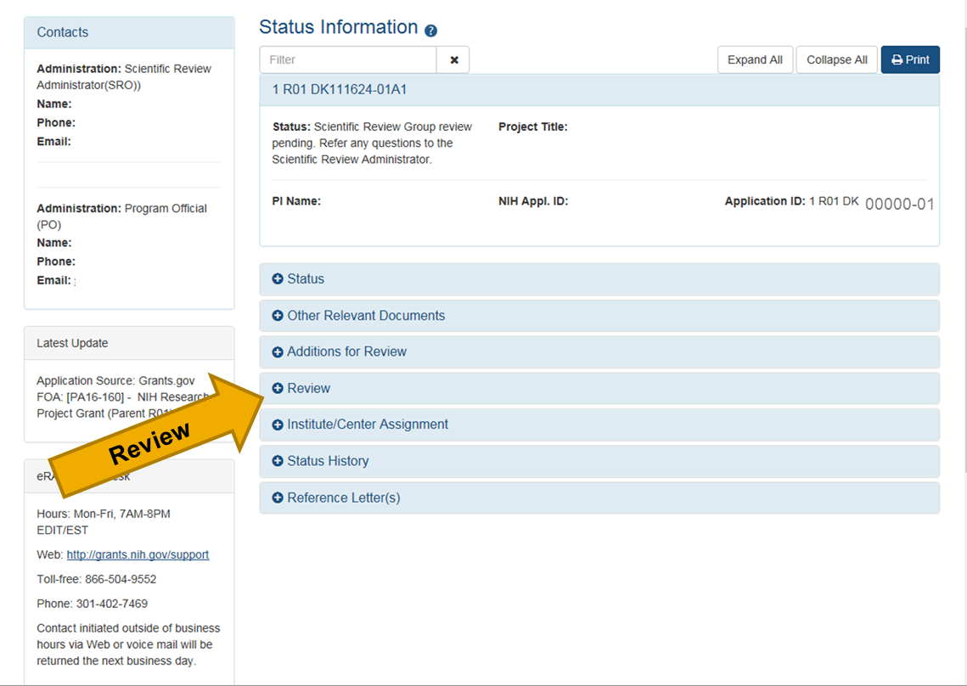
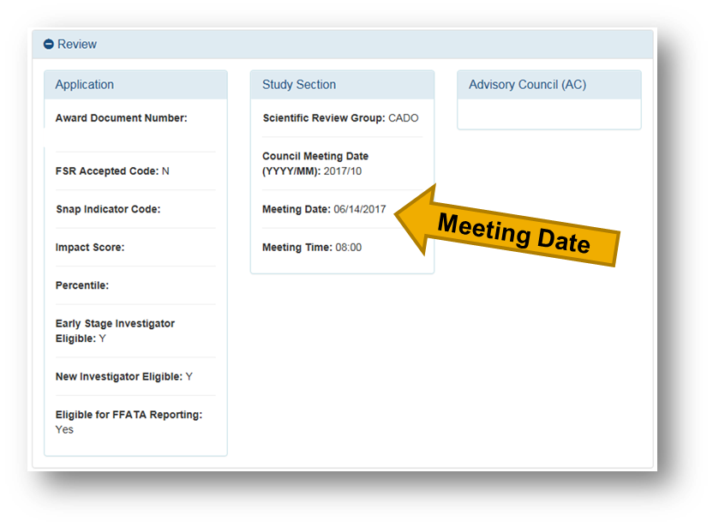
Check the Status of Your Application in NIH eRA Commons

Slide 94
Summary Statement
Feedback to the applicant and the assigned NIH Institute(s) or Center(s) that may fund the application.
Essentially unedited critiques
Scores for each review criterion
Administrative notes if any
Additional information for discussed applications
Summary of review discussion
An overall impact/priority score and percentile
ranking
Budget recommendations

Slide 95
Your Summary Statement
Scores for each review criterion
Critiques from assigned reviewers
Administrative notes if any
If your application is discussed, you also will receive:
An overall impact/priority score and percentile ranking
A summary of review discussion
Budget recommendations
Notes:
The summary (resume) of the discussion itself is written by the SRO
Summary statements are released within 30 days of the meeting except for R01 applications submitted by New Investigators or Early Stage Investigators, which are released within 10 business days of the meeting for first submissions only.
Once received, the Investigator/applicant may then discuss the contents of the summary statement with the Program Officer, but the SRO who prepared it is not at liberty to do so.

Slide 96
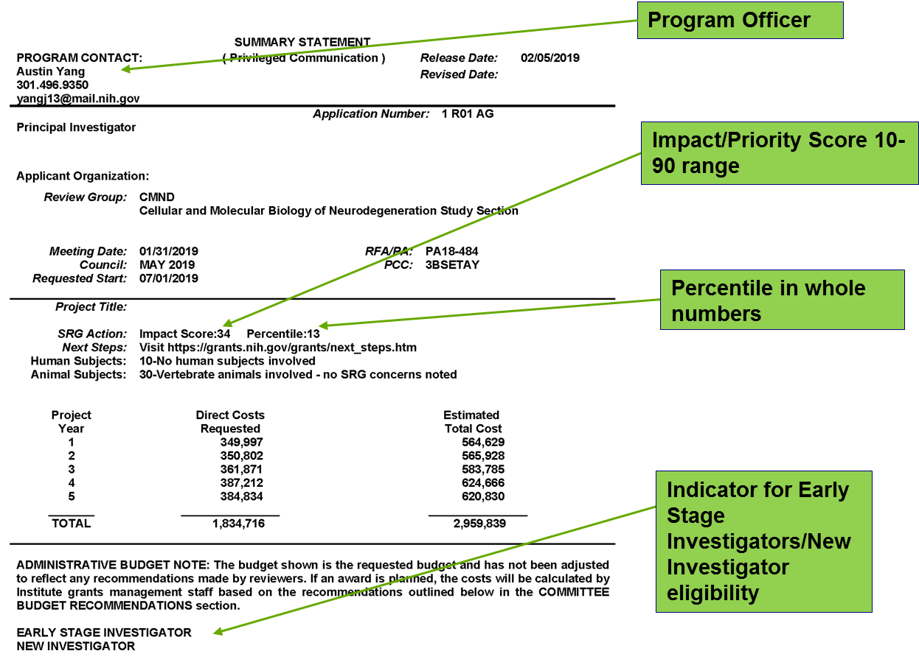
Summary Statement

Slide 97
New Investigators

Slide 98
Your Career Stage Is Considered…
If you are a New Investigator or Early Stage Investigator on an R01 application
If NIH has correct info on the applicant’s career stage
Notes:
When you submit an R01 grant application.

Slide 99
New and Early Stage Investigators
New Investigator (NI)
PD/PI who has not yet competed successfully for a substantial NIH independent research award
Early Stage Investigator (ESI)
PD/PI who qualifies as a New Investigator AND is within 10 years of completing the terminal research degree or is within 10 years of completing medical residency (or equivalent)
http://grants.nih.gov/grants/new_investigators/

Slide 100
Become a Reviewer

Slide 101
Become a Reviewer
Check Out Our Early Career Reviewer Program: www.csr.nih.gov/ecr
Contact a CSR Scientific Review Officer: Send them your CV
Let Us Try to Find a Good Review Group for You: Send your CV to csrvolunteer@mail.nih.gov
www.csr.nih.gov/review4CSR

Slide 102
Jumpstart Your Career: CSR Early Career Reviewer Program
www.csr.nih.gov/ecr

Slide 103
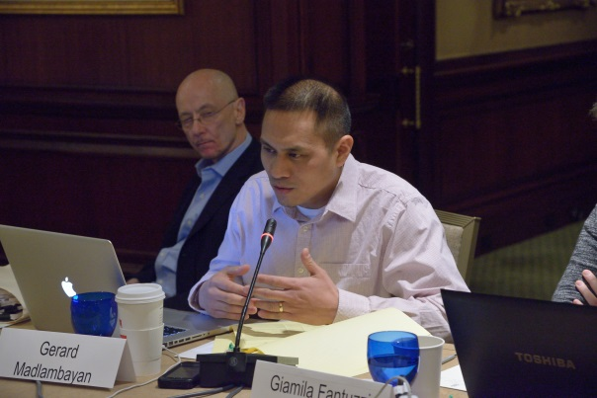
Early Career Reviewer Program Goals
Train and educate qualified scientists to become critical and well-trained reviewers
Expose investigators to the peer review experience to help make them more competitive as applicants
Enrich the existing pool of NIH reviewers

Slide 104
Qualifications for the Early Career Reviewer Program
Demonstrated training and experience in the scientific areas under review as evidenced by:
Two or more years in a faculty appointment or the equivalent
An active independent program of research
At least 2 senior authored research publications in peer reviewed journals in the past 2 years
You cannot have an R01 grant or have served on a CSR study section.

Slide 105
ECR Service
Assigned 2-4 applications as 3rd reviewer
Write full critiques for assigned applications
Participate in one study section meeting

Slide 106
View the Video
Jumpstart Your Research Career with
CSR’s Early Career Reviewer Program
www.csr.nih.gov/video/video.asp
Notes:
Click on the photo and you’ll go to the ECR Video. The slides need to be in slide show mode for the links to work.
Note the CSR video URL goes directly to YouTube instead of the CSR Video page

Slide 107
How Can I Become an Early Career Reviewer?
Apply! Instructions at www.csr.nih.gov/ECR
If you are accepted, we will:
Place your name in our ECR database
Invite you to serve if your expertise is needed to review particular applications

Slide 108
Preparing an Application

Slide 109
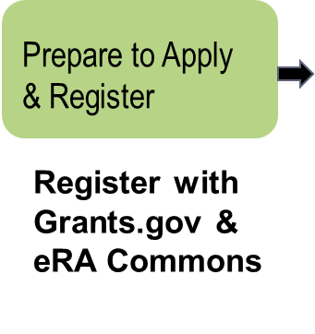
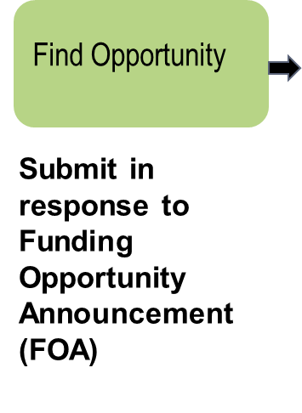
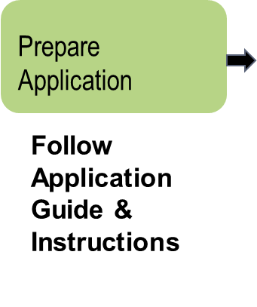
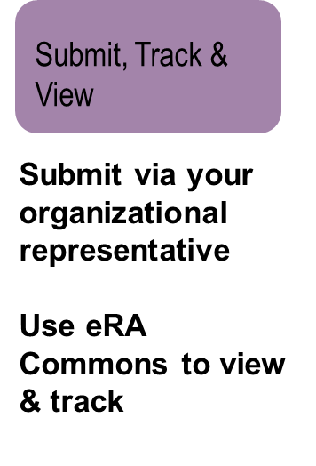
Application Process (Overview)

Slide 110
When Preparing an Application
Read instructions
Clearly state rationale and design of proposed investigation
Provide sufficient detail so reviewers will know what you mean
Refer to pertinent literature
Include well-designed tables and figures
Present an organized, lucid write-up
Obtain pre-review from faculty at your institution
Insider’s Guide to Peer Review for Applicants: http://www.csr.nih.gov/applicantresources/insider
Notes:
http://public.csr.nih.gov/aboutcsr/NewsAndPublications/Publications/Pages/InsidersGuide.aspx

Slide 111
Alignment
Criteria | Application
Significance | Research Strategy a. Significance
Investigator(s) | Biosketch Personal Statement
Innovation | Research Strategy b. Innovation
Approach | Research Strategy c. Approach
Environment | Resources Environment

Slide 112
Grant Writing: A, B, C and D
Ask a successfully funded researcher to critique your grant proposal before you submit it.
Be hypothesis-driven, not technique-driven.
Clearly state what impact your work will have on a field.
Don’t be too ambitious, focus on 3 to 5 specific aims.
Always include preliminary data.
Be considerate of reviewers. Use readable fonts and leave space between paragraphs.
Convey your excitement and enthusiasm.
Discuss data interpretation and alternative hypothesis.

Slide 113
When preparing an application
Read instructions, follow the format.
Explicitly state the rationale.
Include well-designed, clearly labeled tables and figures.
Present an organized and lucid write-up.
Never assume the reviewers “will know what your mean”.
Refer to the literature thoroughly and thoughtfully.

Slide 114
It is about You and Your idea and don’t be sloppy
Beginning investigators must demonstrate command of the material rather than promise earth shattering results.
You must stand out from the crowd.
Take pains to present you and your work positively.
Use spell check.
Include all sections (Other support, Animal welfare, Facilities etc.).
Clarity counts and watch grammar. Avoid jargon.

Slide 115
Demonstrate Command of the material
Cite appropriate literature.
Include preliminary data.
Identify problematic aspects (either hypothesis or technique).
Identify alternatives (i.e., backup strategies).

Slide 116
Implications for your application
Don’t be sloppy.
Demonstrate command of the material.
Help the reviewer find a way to think about and analyze your idea.
Acknowledge the realities of peer review.
Make your strengths the focus of your proposal.
Solicit criticism. Respond to the summary statement.
Don’t pad either the budget or specific aims

Slide 117
Acknowledge the realities of peer review
The competition is formidable-merely meeting the minimum standard will not suffice.
State rationales and hypothesis clearly.
Have an explicit timeline.
A good idea, interesting finding, and promising investigator are not enough; you need to present a compelling grant application.

Slide 118
Solicit (and heed!) criticism
Solicit Criticism: From someone who has a NIH grant like the one you are applying for.
Have them read your proposal as written.
Consult with NIH Program Staff early.
In a revised application respond to everything.
Put all ego aside. If in doubt, do it their way.

Slide 119
Make your strengths the focus of your proposal
Propose experiments that take advantage of Your training. and your expertise and your environment.
Give your application a reviewer friendly format.
If you need a collaborator (s), get a strong one with publication in peer reviewed journals and one who has a grant.

Slide 120
The Successful Grant Application
Novel and interesting experiments.
Advances knowledge in the area of the study.
Hypothesis driven.
Specific aims well defined.
Experimental design well detailed.
Preliminary data support hypothesis.
Studies are well focused.
Expertise is appropriate and documented.
Budget is reasonable and justified.

Slide 121
Unsuccessful Grant Application
Lack of new or original ideas.
Diffuse, superficial or unfocused research plan (poorly written).
Lack of knowledge of published relevant work.
Lack of experience in the essential methodology.
Uncertainty concerning the future directions.

Slide 122
What Reviewers Look for in Applications
Significance and impact
Exciting ideas
Clarity
Ideas they can understand -- Don’t assume too much
Realistic aims and timelines -- Don’t be overly ambitious
Brevity with things that everybody knows
Noted limitations of the study
A clean, well-written application
Insider’s Guide to Peer Review for Applicants: http://www.csr.nih.gov/applicantresources/insider
Notes:
In thinking upon what one of your peers might generally look for as a reviewer of an application keep the following practical ideas in mind:

Slide 123
Common Problems in Applications
Lack of new or original ideas
Absence of an acceptable scientific rationale
Lack of experience in the essential methodology
Questionable reasoning in experimental approach
Uncritical approach
Diffuse, superficial, or unfocused research plan
Lack of sufficient experimental detail
Lack of knowledge of published relevant work
Unrealistically large amount of work
Uncertainty concerning future directions

Slide 124
Insider’s Guide to Peer Review for Applicants Advice from CSR Study Section Chairs http://www.csr.nih.gov/applicantResources/Insider

Slide 125
NIH Guide For Grants and Contracts U.S. Department of Health and Human Services
Announces NIH Scientific Initiatives
Provides NIH Policy and Administrative Information
Supplies links to application forms
Available on the NIH Web Site: http://www.nih.gov

Slide 126
A Window to Your Application: eRA Commons
eRA Commons is an online interface where a grant applicant can:
Check submitted grant application for errors and warnings and view final image
Track review assignment, view review outcomes (score, summary statements), find contact info
Update Personal Profile to ensure Early Stage Investigator eligibility is in place
Submit pre-award information (just in time)
View Notice of Award and other key documents
And much more!
https://commons.era.nih.gov/commons/

Slide 127
NIH Encourages Applicants to Describe their Research in Terms Easily Understood by Reviewers, Scientists, Congress and the Public
Titles, statements of public health relevance & abstracts should:
Convey value of research in plain language
Be understandable by both scientists and the public
Clearly relay the potential impact of the research on health
The public accesses funded NIH grant info through
http://ProjectRePORTER.NIH.gov
Examples and more info: http://grants.nih.gov/grants/plain_language.htm

Slide 128
NIH Encourages Applicants to Describe their Research in Terms Easily Understood by Reviewers, Scientists, Congress and the Public
Titles, statements of public health relevance & abstracts should:
Convey value of research in plain language
Be understandable by both scientists and the public
Clearly relay the potential impact of the research on health
The public accesses funded NIH grant info through
http://ProjectRePORTER.NIH.gov
Examples and more info: http://grants.nih.gov/grants/plain_language.htm

Slide 129
NIH’s Resubmission Policy
After an unsuccessful new (A0) application or an unsuccessful resubmission (A1) application, you may submit a new (A0) application with the same idea as long as your summary statement has been issued.
NIH Guide Notices
NOT-OD-14-074
NOT-OD-14-082
Resubmission FAQs
http://grants.nih.gov/grants/policy/resubmission_q&a.htm

Slide 130
NIH Will Not Accept
An A0 or A1 application that overlaps a funded application
Simultaneous submissions of overlapping applications
An A0 or A1 application before NIH issues the summary statement of an earlier, overlapping application.

Slide 131
Your New Application Must Be Written as New
Your new (A0) application should not contain information that might bias the review or provide a competitive advantage:
You Cannot Refer to a Previous Review
No mention of previous score
No mention of previous reviewer comments
No mention of how the A0 is responsive to previous review
No marks in text to indicate changes
You Cannot Submit Elements of a Renewal
No Progress Report
No Progress Report Publication List

Slide 132
F30 Postdoctoral Fellowship Program
To enhance the integrated research & clinical training of promising pre-doctoral students (MD/PHD, DDS?PHD, DVM/PHD) who intend careers as physician clinical scientists.
OVERALL IMPACT (Following Scored Criteria)
Fellowship Applicant
Sponsors, Collaborators and Consultants
Research Training Plan
Training Potential
Institutional Environment & Commitment to Training
(Protection of Human Subjects, Inclusion of Women & Minorities, Vertebrate Animals, Biohazards etc., not scored)

Slide 133
F31 Individual Pre-doctoral Fellowship
F31 fellowship is to enable promising pre-doctoral students to obtain individualized mentored research training from outstanding faculty sponsors while conducting dissertation research.
OVERALL IMPACT (Scored Criteria below)
Fellowship Applicant
Sponsors, Collaborators and Consultants
Research Training Plan
Training Potential
Institutional Environment & Commitment to Training
Not scored criteria: Protection of Human Subjects, Vertebrate animals, Inclusion of Women, Minorities and Children, Vertebrate animals, Biohazards, Training in the responsible conduct of research, Budget and Period of Support

Slide 134
F99/K00 Pre-doctoral to Postdoctoral Fellow Transition Award
F99/K00 Pre-doctoral to Postdoctoral Fellow Transition Award is to encourage and retain outstanding graduate students and facilitate the transition into research postdoctoral appointments.

Slide 135
NSF-GRFP (Graduate Research Fellowship Program)
Annual grant awarded to about 2000 students pursuing research based Masters and Doctoral degrees in the natural, social and engineering sciences at US institutions.
As of 2019, Honorarium of $12,000 for tuition and fees, also awards $34,000 stipend for 3 years. One time travel award of
$1,000.
Competition is open to US citizens, permanent residents. To apply, applicant must submit biographical information, undergraduate and graduate transcripts, 3 letters of recommendation & two assays, a personal statement with relevant experience and a research proposal stating future goals.

Slide 136
DOD HORIZON AWARD
The goal of Peer Reviewed Cancer Research Program (PRCRP) is to improve mission readiness and quality of life by decreasing the burden of cancer of service members, their families and the American public.
Key Elements: Principal Investigator, both pre-doctoral & postdoctoral fellows are eligible (Within 2 years of completing required graduate courses and within 3 years of completion of his/her terminal degree and working in the mentor’s lab. Mentor must be an experienced cancer researcher).
Must address at least one of the topic areas: 1. Research approach-rational & experimental methodology. 2. Research Development Plan with guidance from the mentor. 3. Impact: Potential for significant impact on at least one of the topic areas.

Slide 137
NSF Early Career Award
This award is to support new investigators as part of the regular (“core”) research competitions. Faculty Early-Career Development Award-Most prestigious Award to help junior faculty member. Goals of the Career Program is to provide stable support for 5 years (greater than or equal to 400 K in most directorates) to allow career development of outstanding new teacher scholars. What should be in a career proposal:
1. Compelling Research Plan.
2. Innovating but doable education plan.
3. Plan for effective integration of both sets of activities (evaluation plan is a big plus).
Letter from Chair to support for the PI’s proposed career research and education activities (US citizen or Permanent Resident)

Slide 138
DOD Early Career Grant Program (Office of Naval Research Young Investigator Program, YIP)
YIP seeks to identify and support academic scientist and engineers who are in their first or second full-time tenure-track academic appointments and who show exceptional promise for doing creative research.
DARPA Young Faculty: Objective of the program is to identify and engage rising research stars in junior faculty positions and introduce them to DOD needs as well as DARPA’S program development process. Program focuses on untenured faculty, those without prior DARPA funding.

Slide 139
F32 Postdoctoral Fellowship Review Criteria
Overall Impact: Enhancing the applicants potential for a productive independent scientific research career (health-related field).
Scored Review Criteria:
Fellowship Applicant: Academic record, research experience.
Sponsors, Collaborators and Consultants: track record, mentoring etc
Training Potential: Individualized mentored experience.
Institutional Environment & Commitment to Training.
Training in the responsible conduct of research (RCR), Adequacy for format, subject matter, faculty participation, duration of instruction and frequency of instruction.
Application from foreign organization

Slide 140
K01, K02, K05, K99/R00 Awards
K01: Mentored Research Scientist Career Development Award to support a postdoctoral or early career research scientists.
K02: Independent Research Scientist Development Award to support of an early to mid career scientists with research funding.
K99/R00: Pathway to Independence Award to support both initial mentored research experience followed by independent research for highly qualified postdoctoral researchers.
K05: Senior Research Scientist Award to support a senior scientist to pursue independent research.

Slide 141
CSR and NIH Information Sources

Slide 142
View the Videos
NIH Peer Review Revealed
What Happens to Your NIH Grant Application
Navigating NIH Peer Review
Jumpstart Your Research Career with CSR’s Early Career Reviewer Program
http://www.csr.nih.gov/video/video.asp

Slide 143
Navigating NIH Peer Review Webinars
For Researchers Seeking:
R01 Grants
Fellowship Awards
AREA/R15 Grants
Small Business Grants
www.csr.nih.gov/webinar

Slide 144
Who Can Answer Your Questions?
Before You Submit Your Application
A Program Officer at an NIH Institute or Center
Scientific Review Officer
After You Submit
Your Scientific Review Officer
After Your Review
Your Assigned Program Officer
GrantsInfo: GrantsInfo@od.nih.gov – 301 945-7573

Slide 145
NIH Peer Review Information on the Web
National Institutes of Health: http://www.nih.gov
Office of Extramural Research
http://www.nih.gov/grants/oer.htm
Grants Policy
http://www.nih.gov/grants/policy/policy.htm
Electronic Submission
http://era.nih.gov/ElectronicReceipt
Center for Scientific Review: http://www.csr.nih.gov
Resources for Applicants
http://www.csr.nih.gov/ResourcesforApplicants
CSR Study Section Descriptions
http://public.csr.nih.gov/StudySections
CSR Rosters and Meeting Dates
http://public.csr.nih.gov/RosterAndMeetings

Slide 146
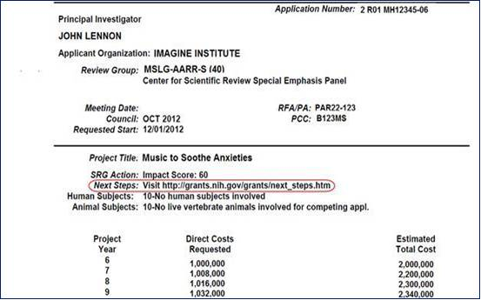
Your Application Was Reviewed What Do You Do Next?
Visit NIH’s Next Steps Website
http://grants.nih.gov/grants/next_steps.htm

Slide 147
CSR Web Site
About CSR
Applicant Resources
Study Sections
Rosters and Meetings
http://www.csr.nih.gov

Slide 148
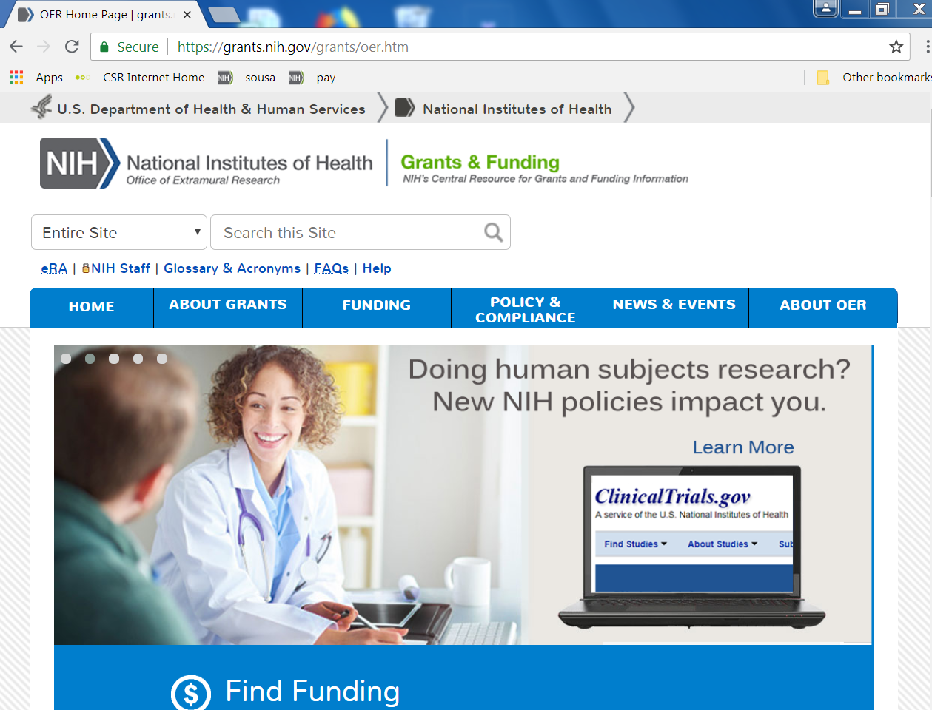
Key NIH Review and Grants Web Sites
NIH Center for Scientific Review
http://www.csr.nih.gov
NIH Office of Extramural Research
http://grants.nih.gov/
Notes:
A lot of critical information and answers to your questions can be found online . . . .

Slide 149
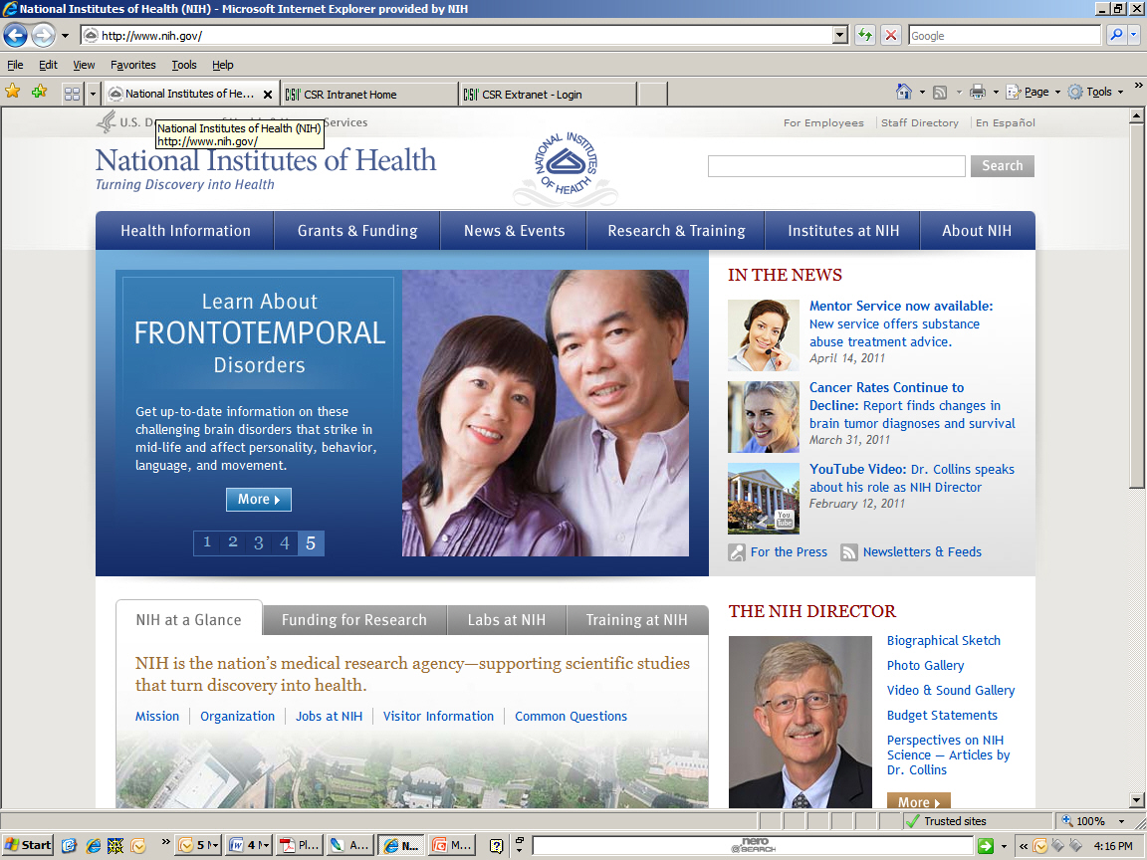
The NIH Web Site
http://www.nih.gov

Slide 150
National Science Foundation Website
NSF Website: https://www.nsf.gov
1. Proposal Preparation and Submission
2. Proposal Review and Processing
3. Award Processing
4. NSF Merit Review Process, two merit review criteria, Intellectual merit and broader impacts
Program Officer makes recommendation to fund or decline proposal
NSF Budget 2019: $7.47 Billion
2020: $7.1 Billion (Will support about 8,000 research grants in the area of basic science)

Slide 151
Department of Defense Website
http://www.defense.gov
https://cdmrp.army/mil (Congressionally Directed Medical Research Program): Review Criteria includes Impact, Research Strategy and Feasibility, Transition Plan with a score). Scale of 1 (Deficient) to 10 (Outstanding). 2019 Budget for CDMRP: $ 350 million

Slide 152
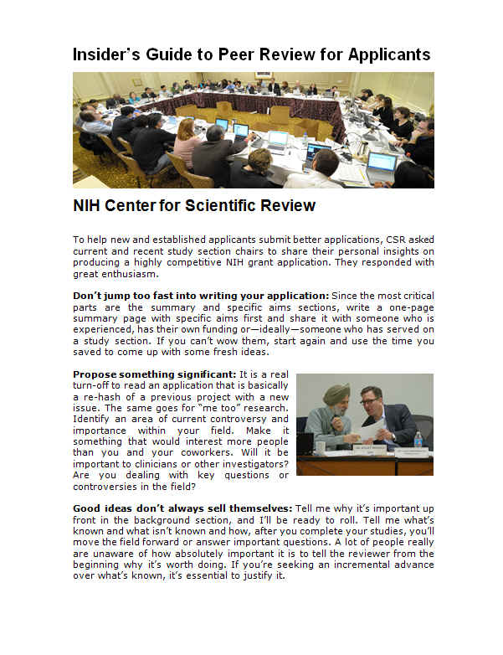
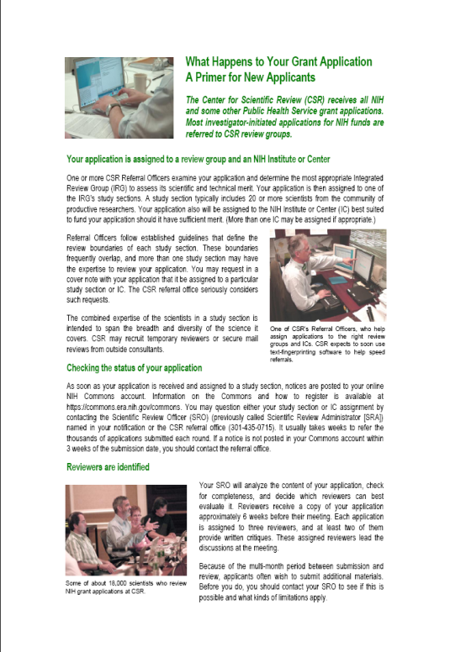
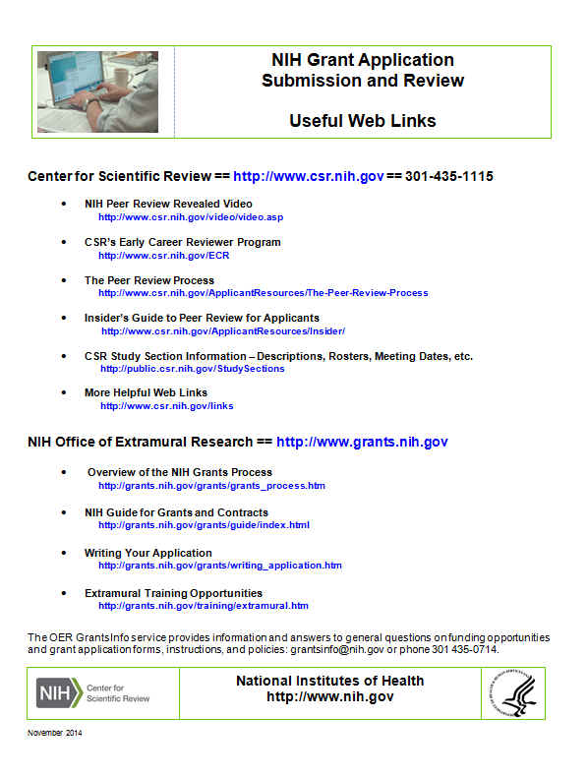
Helpful Handouts
Insider’s Guide What Happens to NIH Grant Application to Peer Review Your Grant Application Useful Web Links
http://www.csr.nih.gov/publications/

Slide 153
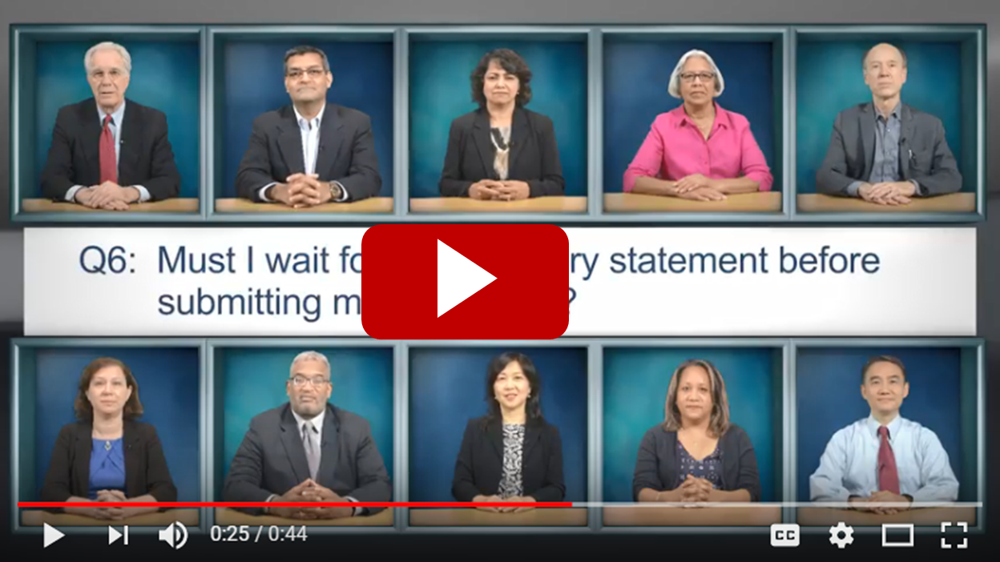
Top 10 NIH Peer Review Q&As
Top 100 NIH Peer Review Q&As
www.csr.nih.gov/faq

Slide 154
History of Peer Review
1944 PHS law authorized Surgeon General to make grants-in-aid to universities etc.
1946 Research Grants office established January 1. Division of Research Grants9 DRG), end of 1946.
1961 Grants Associate Program
1962 DRG Administration of grants and awards to all PHS components
1997 New name Center for Scientific Review (CSR) under Dr. Ellie Ehrenfeld

Slide 155
Quotes and More

Slide 156
“To Maintain Our Edge . . . ”
“we’ve got to protect our rigorous peer review system and ensure that we only fund proposals that promise the biggest bang for taxpayer dollars . . . that’s what’s going to maintain our standards of scientific excellence for years to come.”
Remarks by the President on the 150th Anniversary of the National Academy of Sciences, April 29, 2013

Slide 157
NIH Directors Award

Slide 158
Molecular Cell Biology Study Section with Dr. Joan Brugie – 1990

Slide 159
Symposium: DNA/Chromatin/Transcription

Slide 160
Drs. Elizabeth Blackburn, James Rothman and Martin Chalfie

Slide 161
With JFK, Pandit. Nehru and Indira Gandhi

Slide 162
Ramesh K. Nayak, PhD
Contact Information:
Email address: rnayaksai@yahoo.com
301-839-5883
301-661-7851 cell

Slide 163
Sunset from our home – Fort. Washington, MD

